Slide 1
Use of Color in Data Visualization
Adapted for CNIT 5700 – Fall 2018 Presented by Vetria Byrd, PhD
Assistant Professor
Computer Graphics Technology
Purdue University
Thursday, September 06, 2018
Created By: Jeffrey A. Shaffer Vice President, Unifund Adjunct Faculty, University of Cincinnati (513) 615-0001 | JeffreyShaffer@gmail.com @HighVizAbility
Notes:
Title Slide

Slide 2
Goals
By completing the course modules, students will:
Learn how to use of color in data visualization
Understand color vision deficiency
Learn options for designing colorblind-friendly data visualizations

Slide 3
Use of Color in Data Visualization

Slide 4
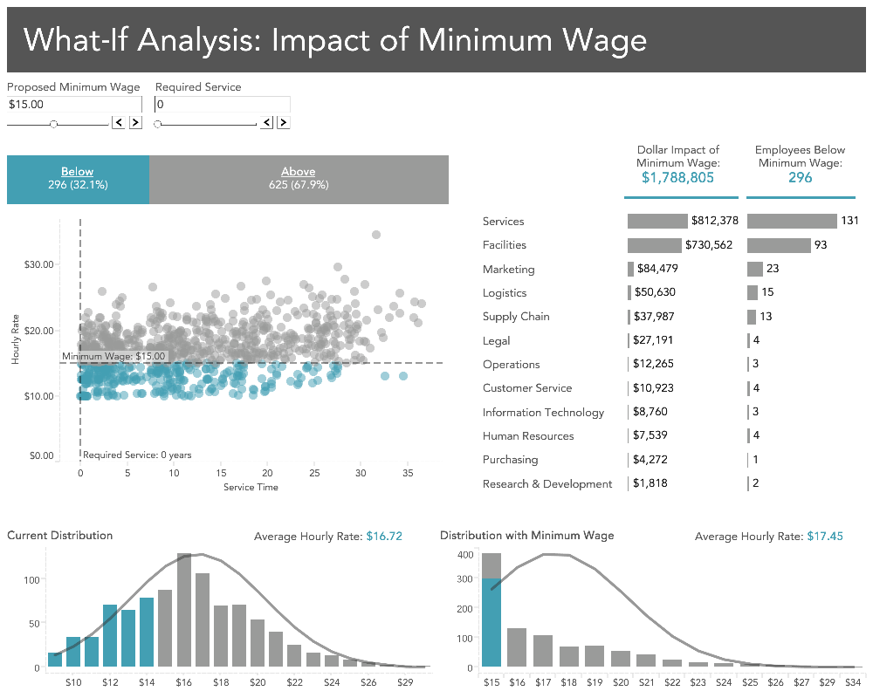
Notes:
Here is an example a dashboard from The Big Book of Dashboards. Notice the use of color here. It’s very simple. Two colors, blue and gray. The blue is used to highlight the data, in this case below minimum wage.

Slide 5
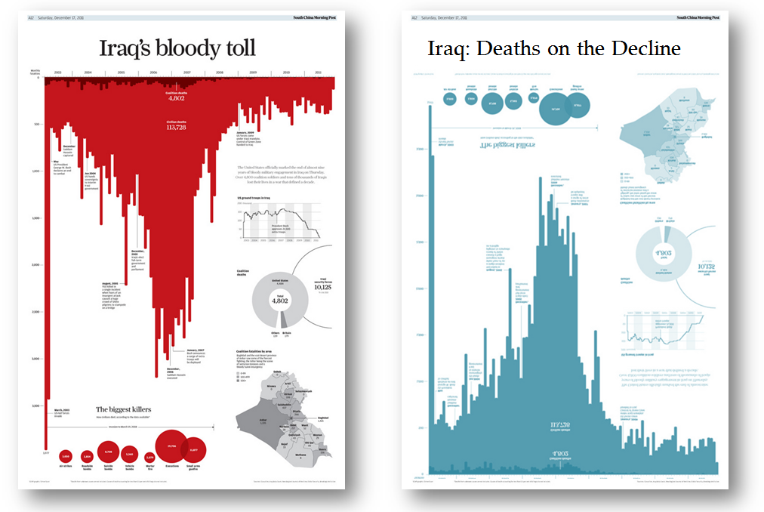
Notes:
Consider these charts. They have completely different messages and yet the only difference is the title, the color and the orientation of the bars.
Taken from: https://youtu.be/Ybwh4lejYO4

Slide 6
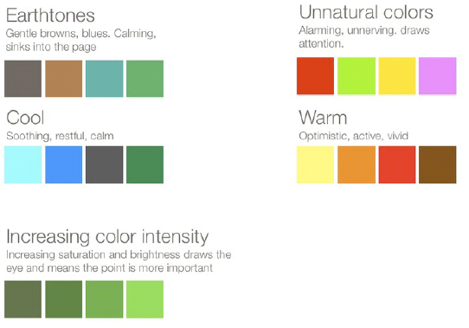
What meaning does color bring to the presentation?
Source: Juice Analytics Whitepaper (part 3)
Notes:
Color is one of the most common ways to visualize data, yet it’s frequently misused. It’s important to think about the purpose of color and how we are encoding the data using color. The colors on the left and earthtones and cool colors. These colors could be used to color code categorical data. The colors on the top-right are unnatural colors. These are colors that will draw a readers a attention. They are alarming and will alert to the reader of something.

Slide 7
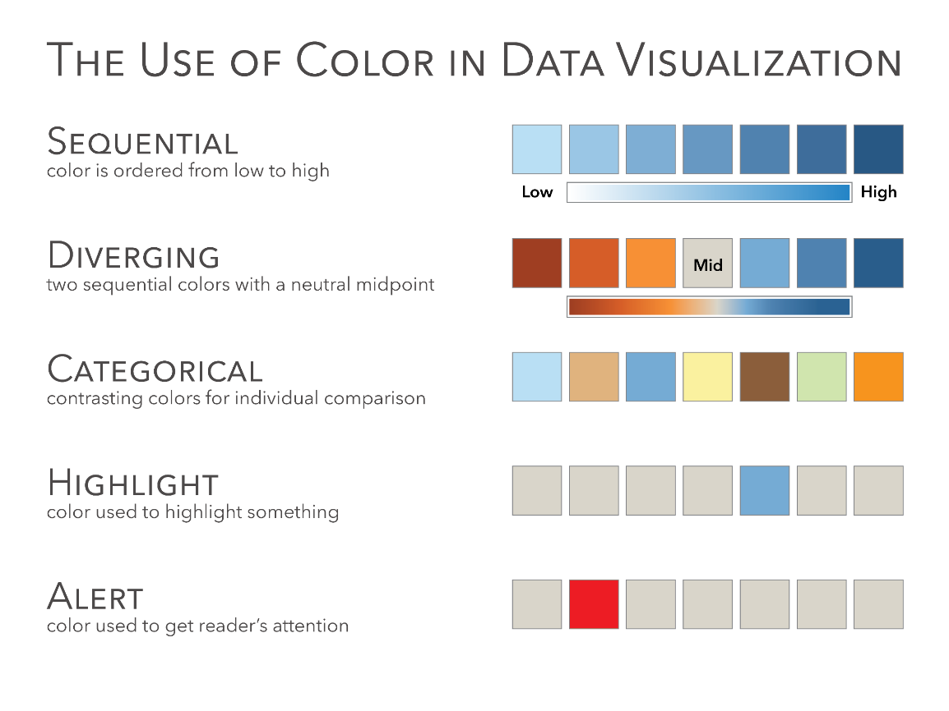
Source: The Big Book of Dashboards (Figure 1.16)
Notes:
Remember this slide from Module 1? This will be important to know for the exam, for your projects in this class and for any data visualization you make after this class is over.
Let’s review again. There are three primary ways you will use color in data visualization is Sequential, Diverging and Categorical.
[Ask the class for examples of data that would be encoded with each method]

Slide 8
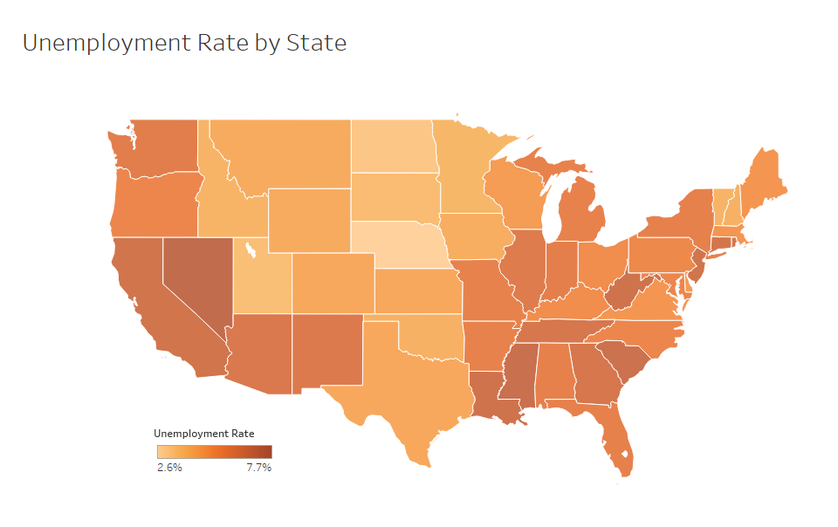
Sequential Color
Source: The Big Book of Dashboards (Figure 1.17)
Notes:
Sequential color encodes a quantitative value from low to high. A great example of this is Sales, which goes from zero to infinity.
Here is an example of a sequential color scheme. This map shows the unemployment rate by state, going from 2.6% up to 7.7% using a sequential color scheme.

Slide 9
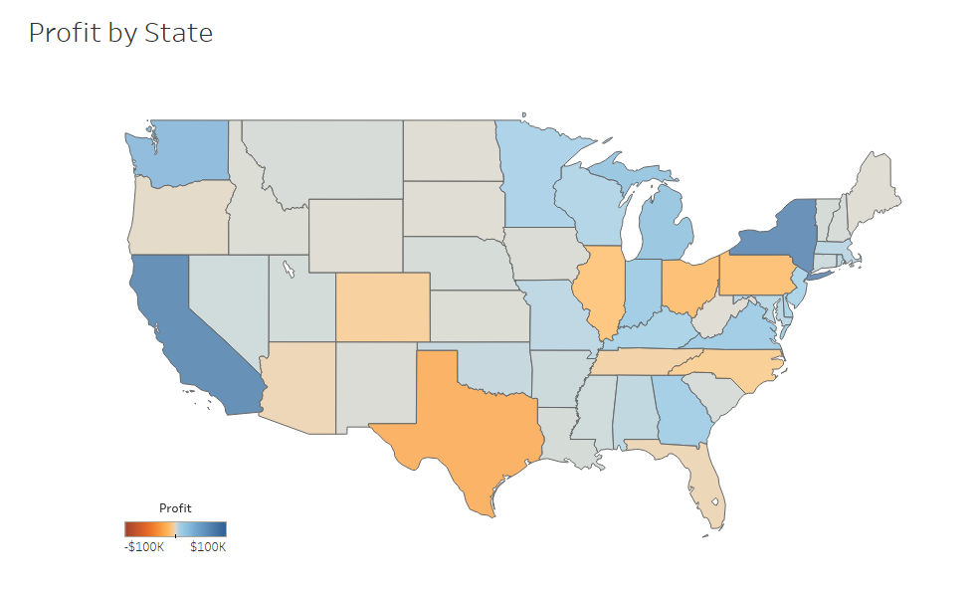
Diverging Color
Source: The Big Book of Dashboards (Figure 1.19)
Notes:
Diverging color encodes a quantitative value but has a midpoint. The midpoint could be zero, for example, displaying Profit. Profit can be positive, encoded in blue with darker blue higher profit. Profit could also be negative, encoded in orange with the darker orange showing a bigger loss.
NOTE - The midpoints does not have to zero. It could be the average, where it shows the average unemployment rate in the country and then one color showing the states below the average and the other color above the average. It could also be a target value, such as last year’s sales or this years projections and the two colors would encode values above and below that target.

Slide 10
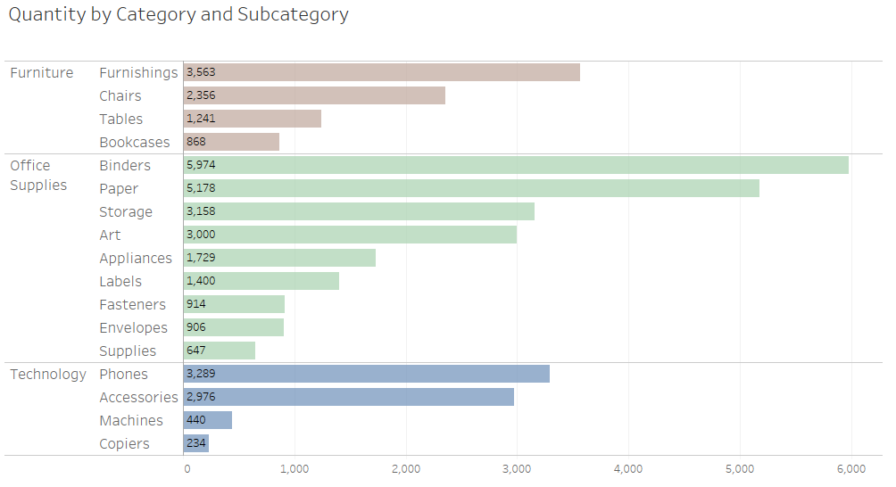
Categorical Color
Source: The Big Book of Dashboards (Figure 1.20)
Notes:
Categorical colors encode categories. Apples, bananas, oranges, pears, or shoes, socks, shirts and ties. It would be very difficult to use a sequential color scheme for categories and trying to figure out which shade of blue means shirst or pants.

Slide 11
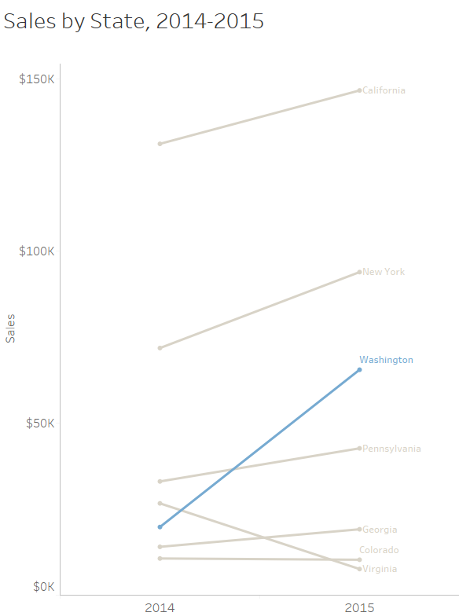
Highlight Color
Source: The Big Book of Dashboards (Figure 1.21)
Notes:
A Highlight color is used to highlight one data point or category. For example, if you have 50 lines, each representing one state, then you might highlight one state. This allows the reader to see for example California versus all of the other states. This slopegraph is filtered to show 7 states and Washington is highlighted.

Slide 12
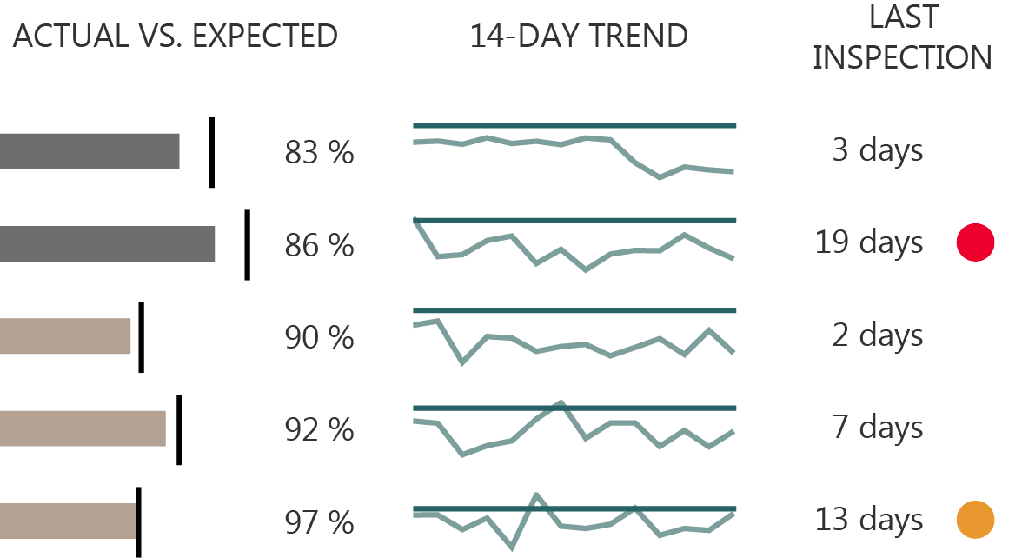
Alerting Color
Source: The Big Book of Dashboards (Figure 1.22)
Notes:
Alerting colors are used to draw the readers attention, similar to Highlight, but in this case it’s done with an alarming or alerting color to tell the reader that something is wrong. It needs the readers attention. Note that in Western culture that red is often associated with bad. This may not be the case in other countries (ex. China). Bright alerting colors could be red, orange or yellow.

Slide 13
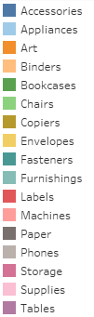
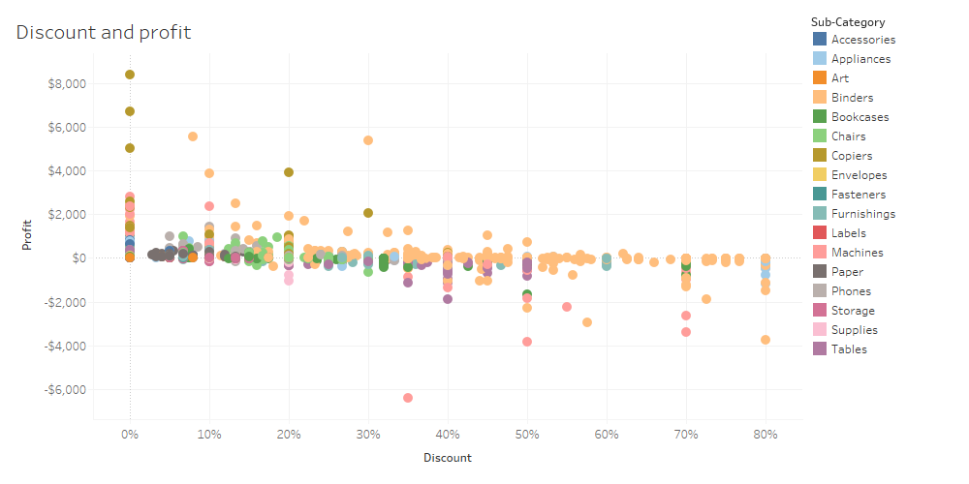
Too Much Color
Short-term Memory = “small chunks of information”
Requires reusing the same or similar color
Requires frequent reference to the legend
Notes:
Remember in module 1 we discussed long-term memory vs. short-term memory. Our long-term memory works very well for storing images of past experience that constantly reference, but our short-term memory can only hold so much. It’s our working memory and it can be overloaded quickly and easily. Using too many colors also means that you will eventually run out of colors that have lots of contrast. You will end up with the similar colors, for example “Storage” and “Tables” are very similar.

Slide 14
Too Much Colors

Slide 15
Color Vision Deficiency
(aka Colorblind)

Slide 16
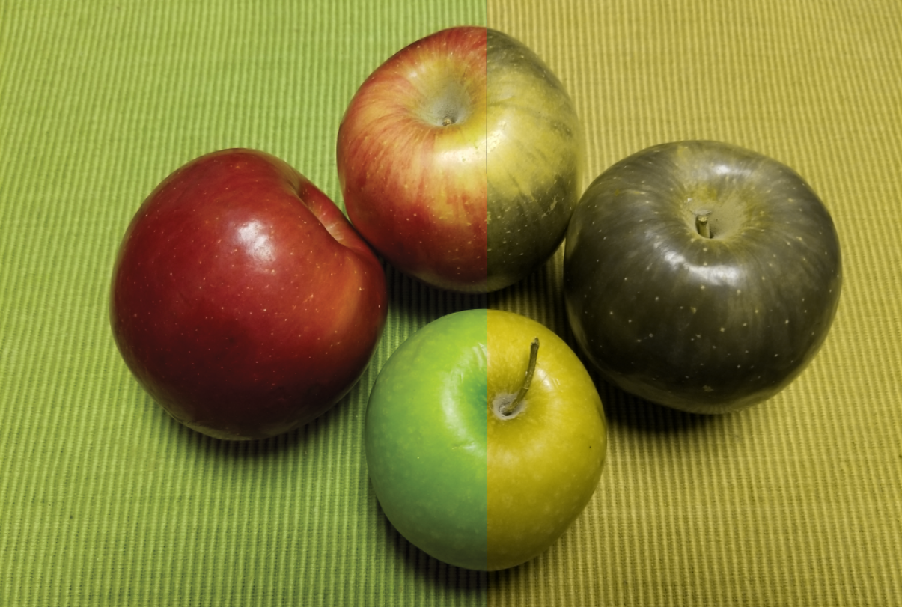
Color
Normal
Color
Vision
Deficiency

Slide 17
The Eye with Normal Color Vision
Three types of color sensitive cones
Short (S) – respond to short wave lengths
Medium (M) - respond to medium wave lengths
- more sensitive to green colors
Long (L) - respond to long wave lengths
- more sensitive to red colors
Notes:
In normal color vision, the eye has 3 types of types of cones. Each type of cones responds to the different wave lengths. The Medium cones are more sensitive to green colors and the Long cones are more sensitive to red colors.

Slide 18
Color Vision Deficiency
2 cones
(dichromat)
(L) protanopia
red-blind
(M) deuteranopia
green-blind
3 cones
(trichromat)
(L) protanomaly
red-weak
(M) deuteranomaly
green-weak
1 out of 100 men
1 out of 100 men
1 out of 100 men
5 out of 100 men
no perceptible difference between red, orange, brown, and green
= approximately 8% of men have color vision deficiency
Notes:
In normal color vision, the eye has 3 types of types of cones. Each type of cones responds to the different wave lengths. When one cone is missing then a person is red-blind or green-blind depending on if it’s an L-cone or an M-Cone. If the person has 3 cones and has color vision deficiency then they are either red-weak or green-weak depending on the L-cone or M-cone.
Approximately 8% of men are colorblind and less than one half of one percent of women. Both the L and M cones are coded to the X chromosome. Women have two X chromosomes and can often overcome this. Men only have one and therefore are more often affected.
Even more rare is someone with an absence of S-cones (1 in 10,000 men or women).
8% may not seem like much, but in predominantly white cultures, the numbers are higher, up to 12% of men. Even at 10%, it doesn’t take very many men in a room to have someone that suffers from color vision deficiency. This becomes a much bigger issue in large organizations or where visualizations are created for the general public.

Slide 19
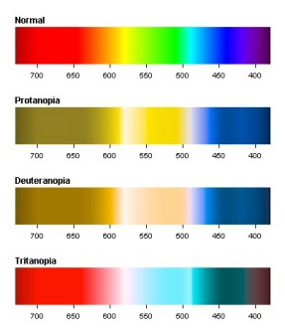
How Color is Perceived by Someone with CVD
Source: www.colblindor.com
Notes:
2 cone Dichromats: Deuteranopia (also called green-blind). In this case the medium wavelength sensitive cones (green) are missing. A deuteranope can only distinguish 2 to 3 different hues, whereas somebody with normal vision sees 7 different hues.
3 come Anomalous Trichromats: Deuteranomaly (green-weak). This can be everything between almost normal color vision and deuteranopia. The green sensitive cones are not missing in this case, but the peak of sensitivity is moved towards the red sensitive cones.

Slide 20
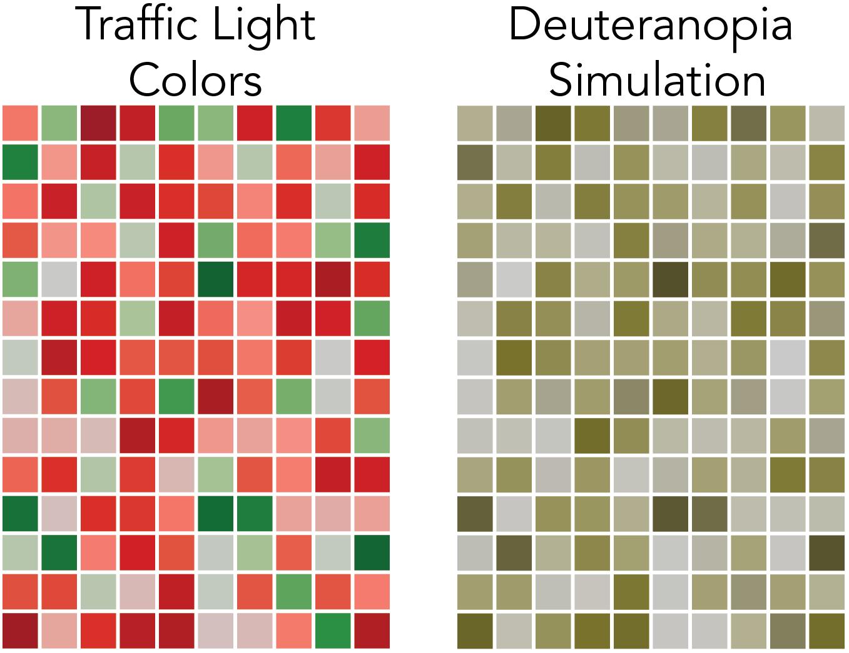
In this case, the colors red and green are the only way to tell one square apart from another square. Notice in the deuteranopia simulation that it is impossible to tell the difference between most of the green and red squares.
This is an example of the traffic light colors in a table where there is no other accommodation for someone with CVD.
Source: The Big Book of Dashboards (Figure 33.3)
Notes:
This is an example of the traffic light colors in a table where there is no other accommodation for someone with CVD. In this case, the colors red and green are the only way to tell one square apart from another square. Notice in the deuteranopia simulation that it is impossible to tell the difference between most of the green and red squares.

Slide 21
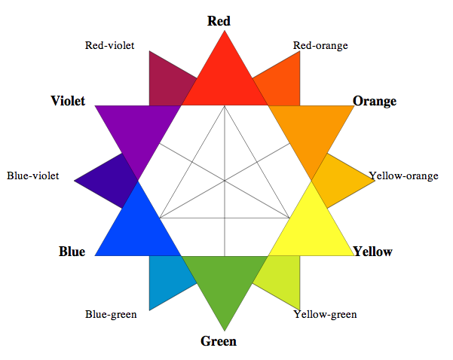
Color
Blue for good instead of green and orange for bad instead of red.
The color combination could also be blue and red, because it’s the blue color that is the most friendly to people with CVD.
If we go back to the color wheel, we see that green and red are opposite each other.
So what many data visualization designers will do is to turn on the color wheel clockwise to blue and orange.
Notes:
If we go back to the color wheel, we see that green and red are opposite each other. So what many data visualization designers will do is to turn on the color wheel clockwise to blue and orange. Blue for good instead of green and orange for bad instead of red. The color combination could also be blue and red, because it’s the blue color that is the most friendly to people with CVD.

Slide 22
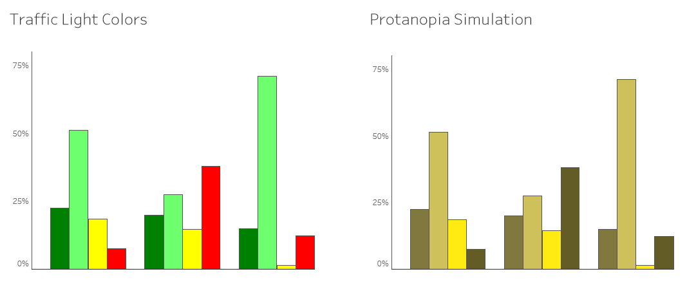
VisCheck www.vischeck.com
Here is an example of bar chart with the traffic light colors and a Protanopia simulation. Look closely at the dark red versus the dark green.
Source: The Big Book of Dashboards (Figure 1.24)
Notes:
Here is an example of bar chart with the traffic light colors and a protanopia simulation. Look closely at the dark red versus the dark green.

Slide 23
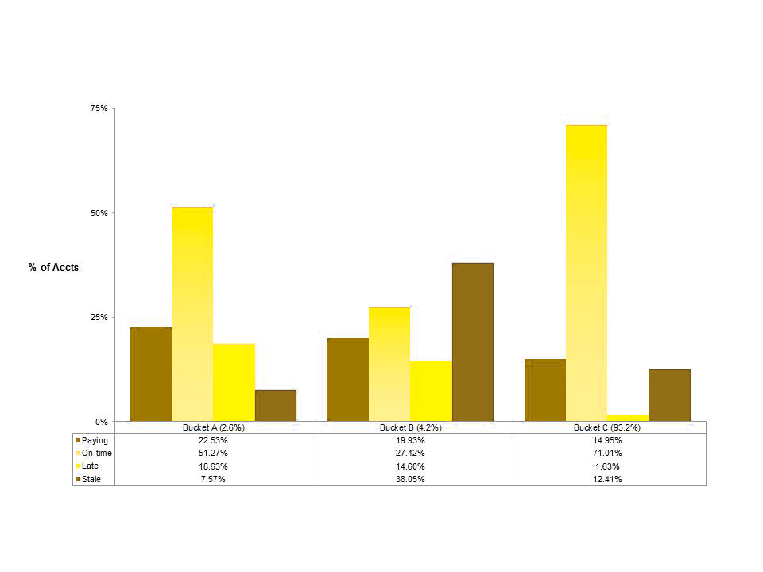
Protanope Simulation
Here’s a close up. It’s impossible to tell the difference between the dark red and the dark green.
Notes:
Here’s a close up. It’s impossible to tell the difference between the dark red and the dark green.

Slide 24
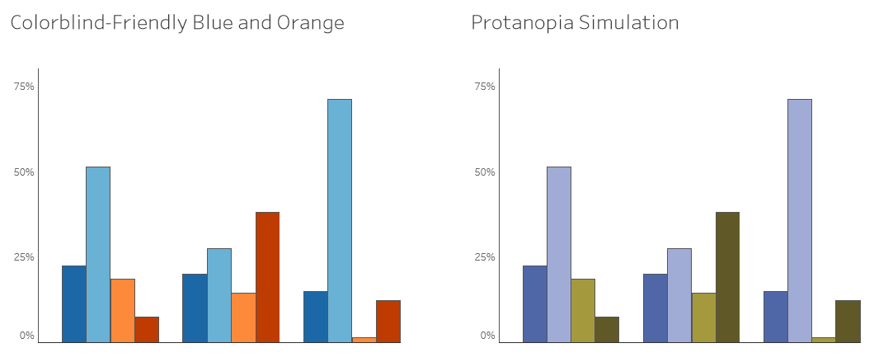
Here’s that same visualization using a colorblind-friendly palette. Tableau has this colorblind-friendly palette built into the software and the colors used here are very similar to Tableau’s colors, with blue and orange.
VisCheck www.vischeck.com
Source: The Big Book of Dashboards (Figure 1.25)
Notes:
Here’s that same visualization using a colorblind-friendly palette. Tableau has this colorblind-friendly palette built into the software and the colors used here are very similar to Tableau’s colors, with blue and orange.

Slide 25
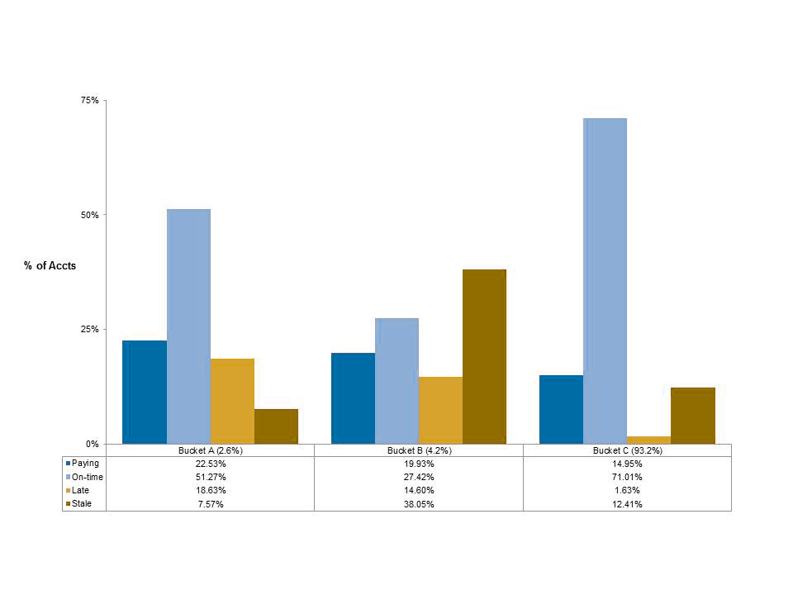
Protanope Simulation
Notice how easy this is to see, even under color vision deficiency simulation. The blue is easy to see, even as the orange turns to a shade of brown.
Notes:
Notice how easy this is to see, even under color vision deficiency simulation. The blue is easy to see, even as the orange turns to a shade of brown.

Slide 26
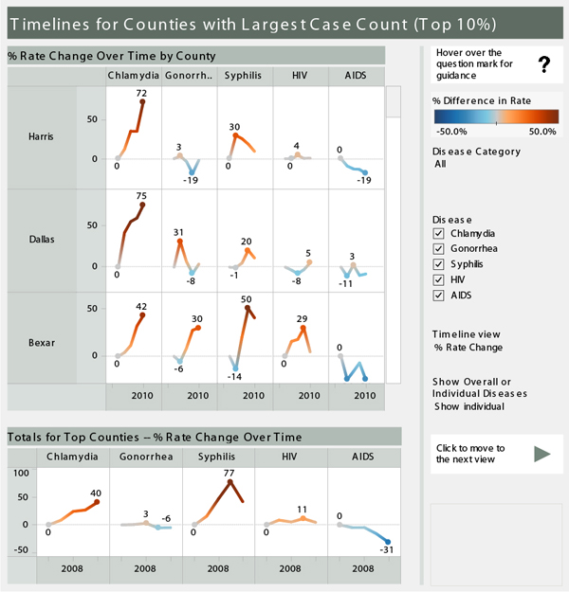
Notes:
This viz by Steve Wexler shows a great example of the Tableau colorblind friendly palette being used. Steve should sexually transmitted diseases in thee counties in Texas as a trend over time in a small multiple design. Orange indicates higher STD rates, which is bad and blue indicates lower STD rates, which is good. This diverging color scheme works very well and is colorblind-friendly.

Slide 27
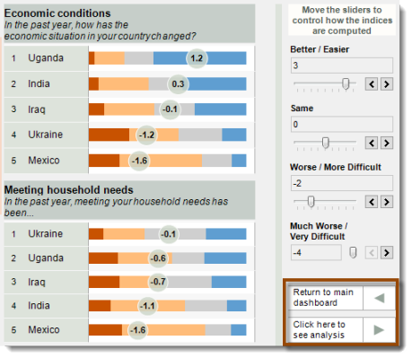
Notes:
This is another visualization by Steve, this time showing survey data on a Lickert scale. Again, Steve used orange, gray and blue to create excellent contrast between the colors, even for someone with CVD.

Slide 28
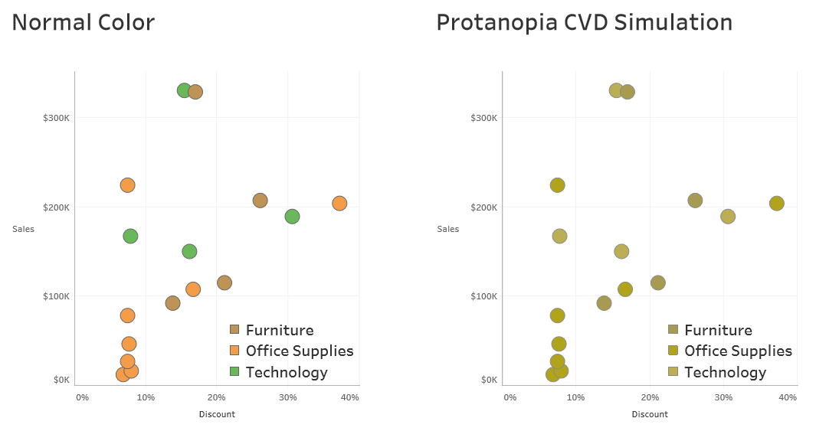
In this example there is no red, but the green, orange and brown all appear to be the same color under CVD simulation.
Source: The Big Book of Dashboards (Figure 1.26)
Notes:
Keep in mind that it’s not just red and green. People in the data visualization community tend to discuss red and green more than the other colors, probably because the traffic light colors are still prevalent in business intelligence and visualization software. Instead of saying “don’t use red and green”, it would be more accurate to say “don’t use red, green, orange and brown” together. In this example there is no red, but the green, orange and brown all appear to be the same color under CVD simulation.

Slide 29
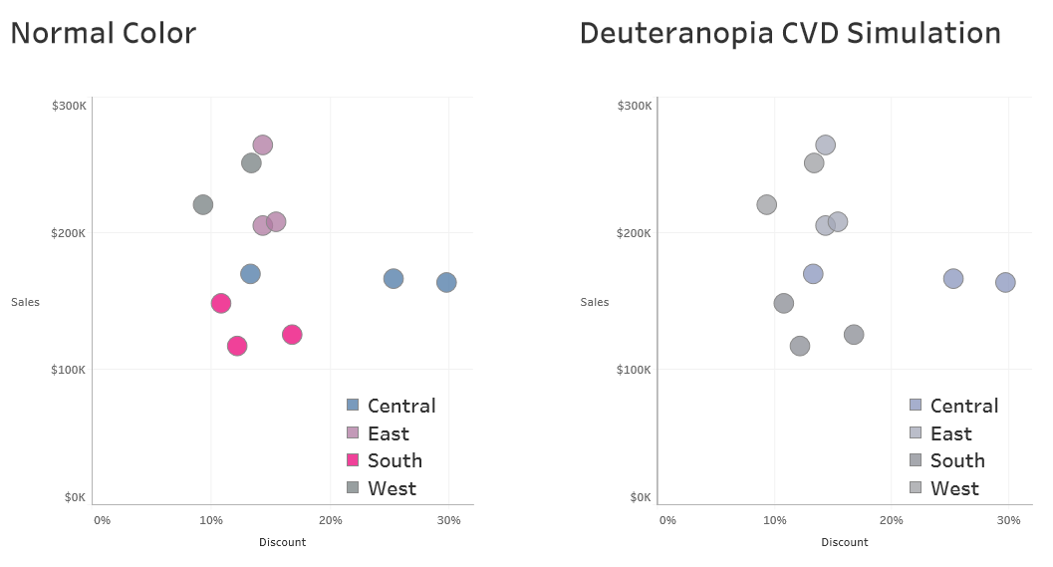
Source: The Big Book of Dashboards (Figure 1.27)
Notes:
There are also concerns with other colors, for example this purple and fuchsia colors are problematic with the gray colors under CVD simulation. The blue is also difficult because it has gray hints to it, making it very close to the other colors.

Slide 30
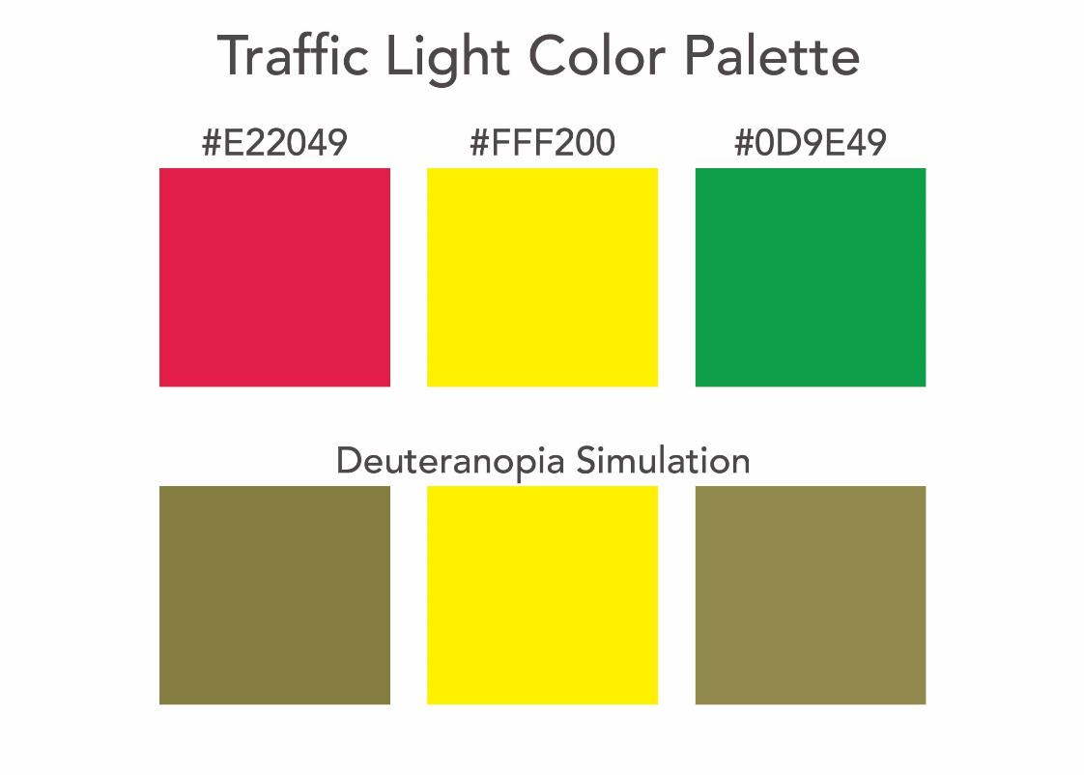
Here is a standard traffic light color palette and CVD simulation.
If using the traffic light colors like this, be sure that the reader has some other accommodation to the data so that people with CVD will be able to read and understand the use of color in your visualization.
Source: The Big Book of Dashboards (Figure 33.8)
Notes:
Here is a standard traffic light color palette and CVD simulation. If using the traffic light colors like this, be sure that the reader has some other accommodation to the data so that people with CVD will be able to read and understand the use of color in your visualization.
However, you might be forced into the traffic light colors, even in situation when you can’t create an accommodation. In this case, here are some color palettes that should help you design traffic light colors that can be useful.

Slide 31
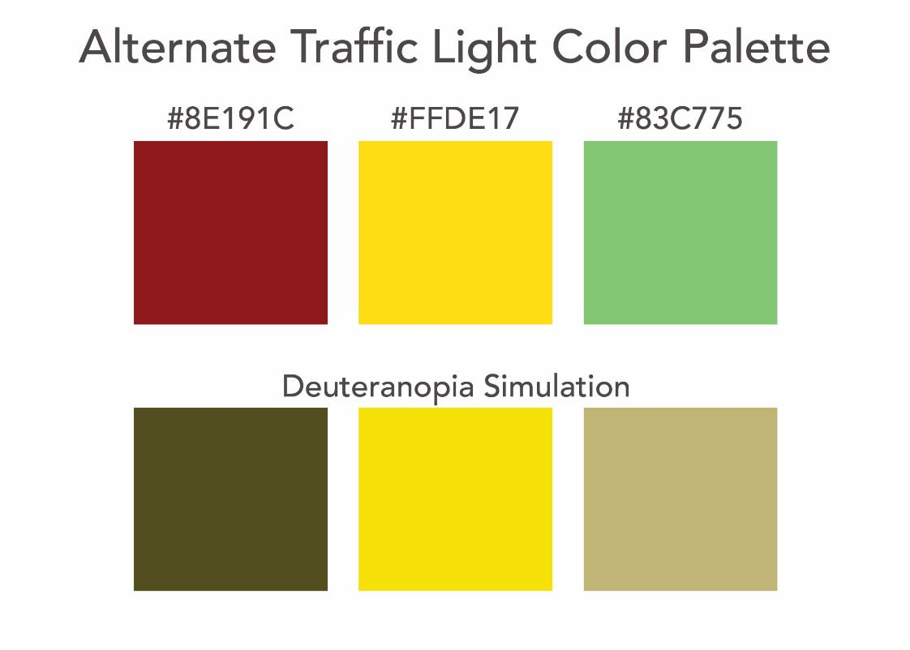
Source: The Big Book of Dashboards (Figure 33.9)
Notes:
One thing you can do is leverage light and dark colors. You can make the red very dark and the green very light or vice versa. People with CVD can typically tell the difference between light and dark colors. By making the red a deep, dark red and the green on the lighter side, it’s easy to see the contrast between the two.

Slide 32
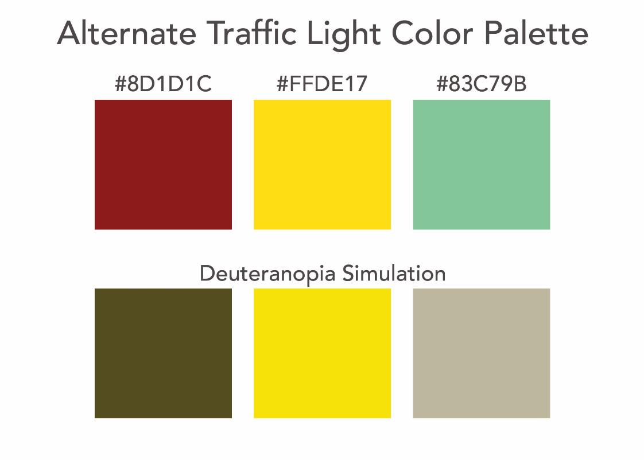
Source: The Big Book of Dashboards (Figure 33.10)
Notes:
If you have the ability to change the colors even more, try adding some blue to the green color. This adds even further contrast between the colors. The executive or stakeholder can have their traffic light colors, but you’ve accommodated people with CVD at the same time.

Slide 33
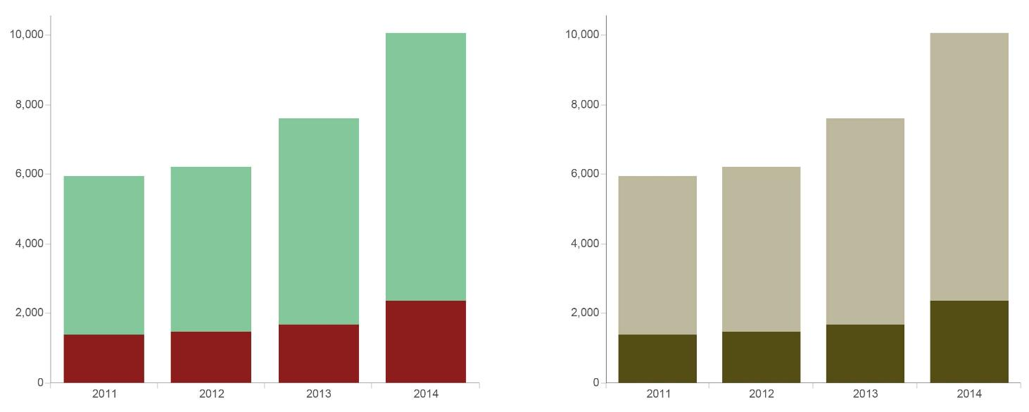
Example in Practice
Source: The Big Book of Dashboards (Figure 33.11)
Notes:
This is a great example of a chart that wouldn’t work well at all for someone with CVD. Using traffic light colors, they might not be able to tell the difference in the bars. However, in this case, the last color scheme with a hint of blue has been used and we can clearly seem the difference in the top bad to the bottom bar.

Slide 34
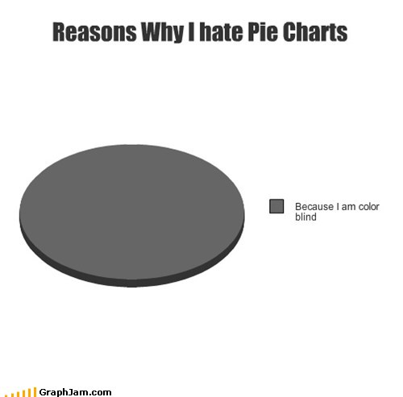
Notes:
And this chart from Graph Jam shows yet another reason why we hate pie charts. If the slices were red, green, orange and brown, the chart might actually look very similar to this chart with one single color.

